Slide 1
SERVICE ORIENTED ARCHITECTURE
Source :-
Web Services Platform Architecture: SOAP, WSDL, WS-Policy,
WS-Addressing, WS-BPEL, WSReliable Messaging, and More By Sanjiva Weerawarana, Francisco Curbera, Frank Leymann, Tony Storey, Donald F. Ferguson

Slide 2
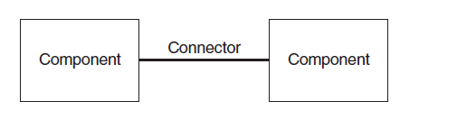
Software - Connector’s
Components are not necessarily entity beans or distributed objects.
They are Abstract modules of software deployed as a unit onto a server with other components.
The interactions between components are called connectors.
The configuration of components and connectors describes the way a system is structured and behaves

Slide 3
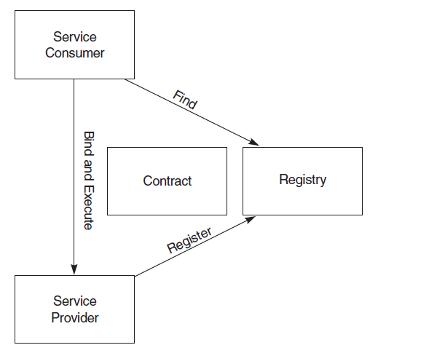
Importance of SOA Paradigm
The most important aspect of SOA is that .,
It separates the service’s implementation from its interface.
In other words, it separates the “what” from the “how.”

Slide 4
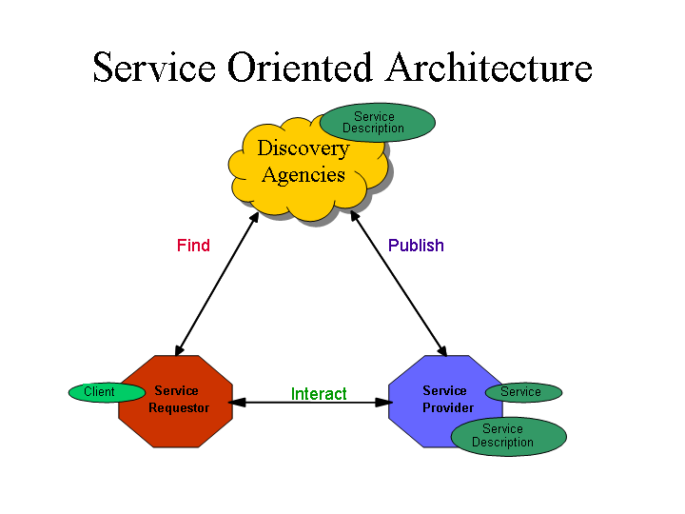

Slide 5
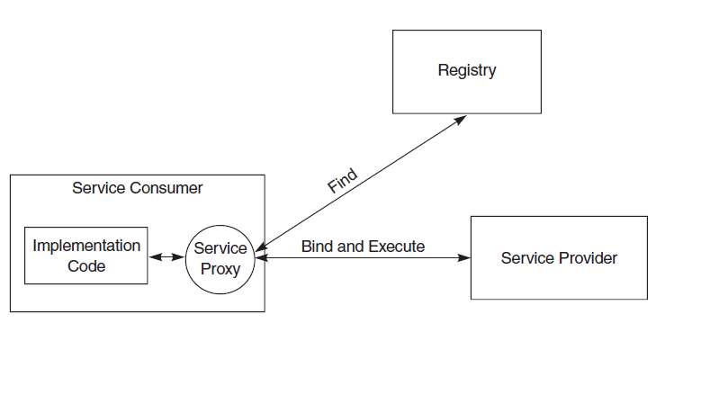
SOA – Service Proxy Paradigm

Slide 6
A service Proxy
The service provider supplies a service proxy to the service consumer. The service consumer executes the request by calling an API function on the proxy.
The service proxy, finds a contract and a reference to the service provider in the registry. The proxy design pattern
states that the proxy is simply a local reference to a remote object (Gamma et al. 2002).
A service provider will provide proxies for many different environments. A service proxy is written in the native language of the service consumer.
Although the service proxy is not required, it can greatly improve both convenience and performance for service consumers.

Slide 7
Conceptual model
The conceptual model of the business, sometimes referred to as the business architecture (Fowler 1997), helps drive the expected use of the services.
A conceptual model is one created without regard for any application or technology. It typically consists of a structural model derived from a set of use cases that illustrate how the business works.

Slide 8
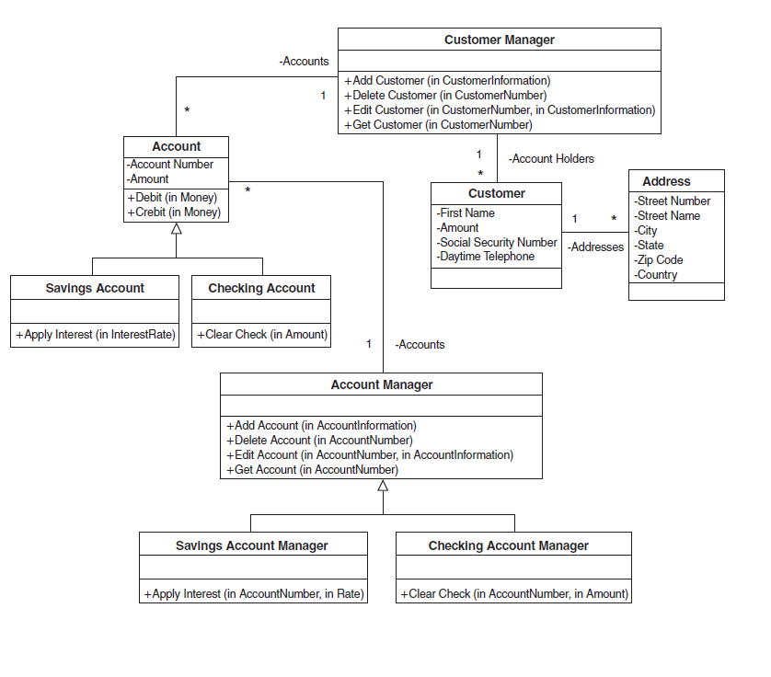
Conceptual Service Model

Slide 9
High-level architecture of the service bus as a stack of SOA capabilities
The bottom layer presents its capabilities to cope with various transport protocols to communicate between a service and a requester.
The messaging layer on top of the transport layer enables the bus to deal with messages, both XML and non-XML.
The actual quality of services that the bus enforces based on appropriate parameterization via polices
This layer copes with security aspects such as message integrity, confidentiality, and nonrepudiation, but also with reliable transport of messages and various kinds of transactions.
The top layer represents the various kinds of virtual components that Web services represent.

Slide 10
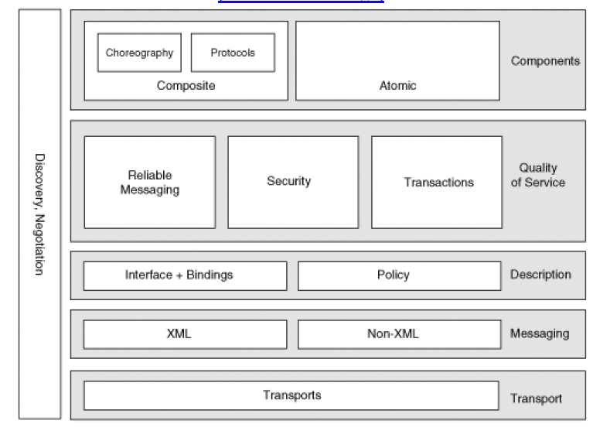
SOA –Stack

Slide 11
SOA - Characteristics
• Services are discoverable and dynamically bound.
• Services are self-contained and modular.
• Services stress interoperability.
• Services are loosely coupled.
• Services have a network-addressable interface.
• Services have coarse-grained interfaces.
• Services are location-transparent.
• Services are composable.
• Service-oriented architecture supports self-healing.

